Slide 1
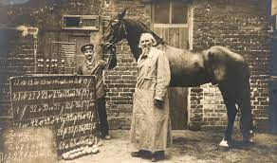
Explainability & Common Robustness
姜育刚，马兴军，吴祖煊

Slide 2
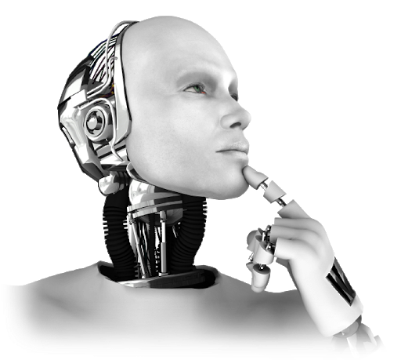
Recap: week 1
1. What is Machine Learning
2. Machine Learning Paradigms
3. Loss Functions
4. Optimization Methods

Slide 3
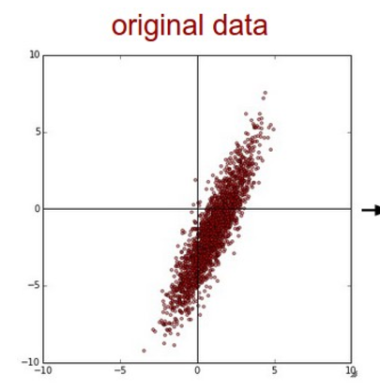
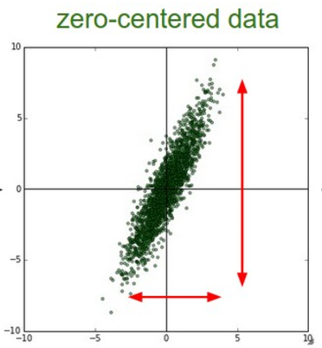
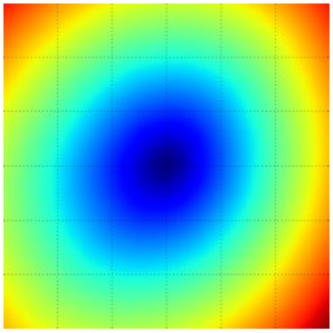

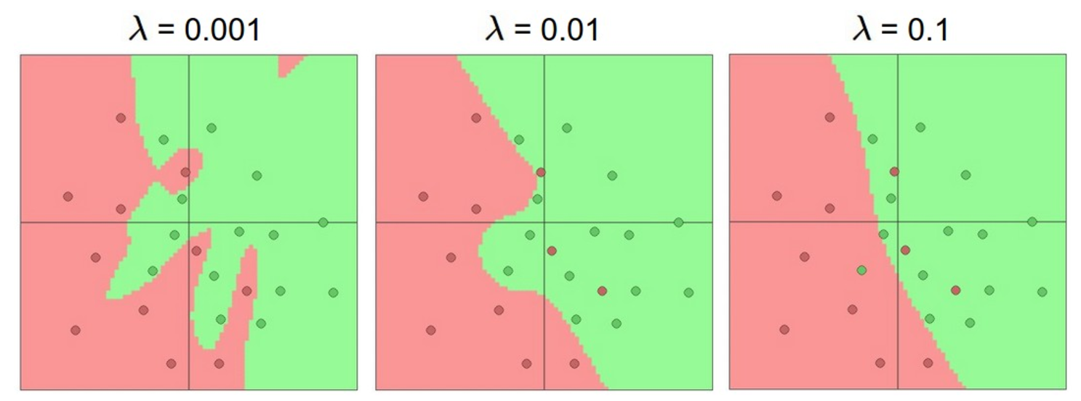
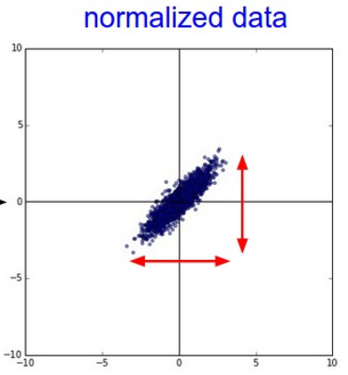
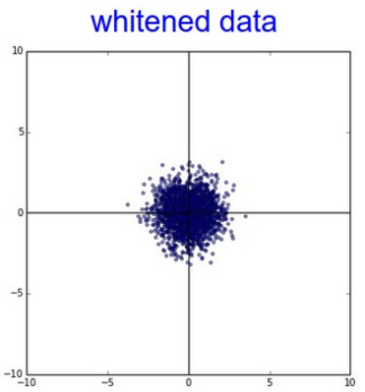
Machine Learning Pipeline
setup the input
setup the optimiser
setup the loss
landscape of a loss function, it varies w.r.t. data, the function itself
regularization makes decision region smoother

Slide 4
Machine Learning Pipeline
Model？
setup the input
setup the optimiser
setup the loss
landscape of a loss function, it varies w.r.t. data, the function itself
regularization makes decision region smoother

Slide 5
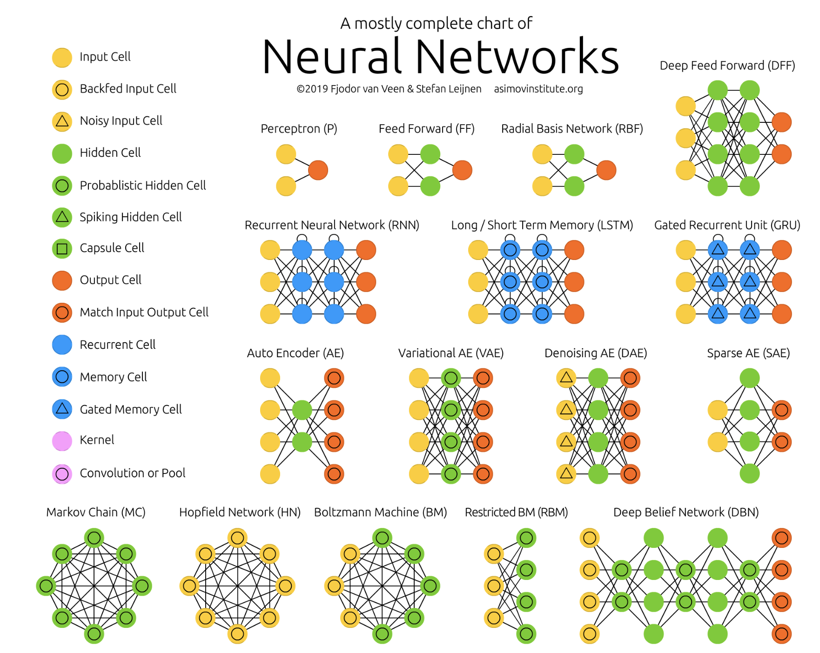
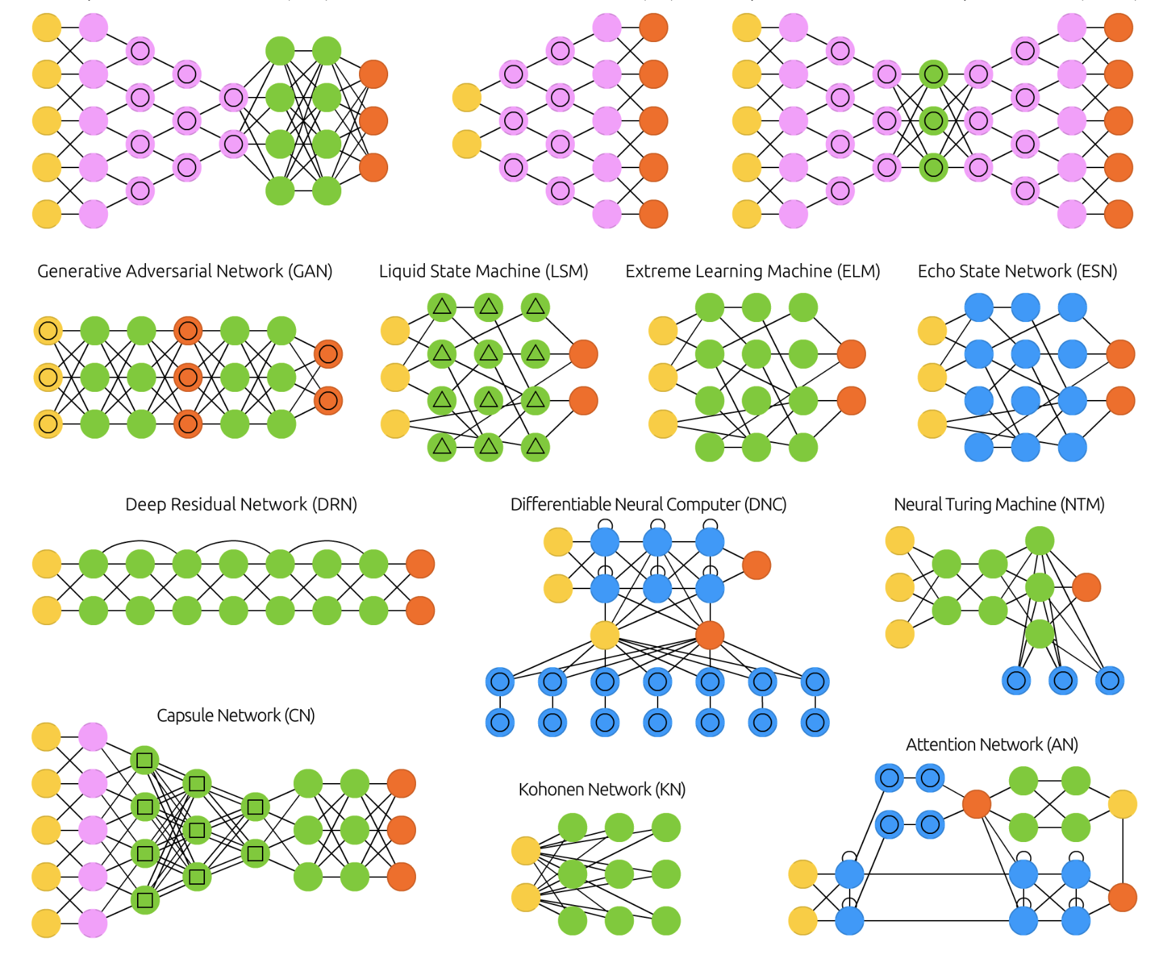
Deep Neural Networks
https://www.asimovinstitute.org/neural-network-zoo/; https://developer.ibm.com/articles/cc-machine-learning-deep-learning-architectures/

Slide 6
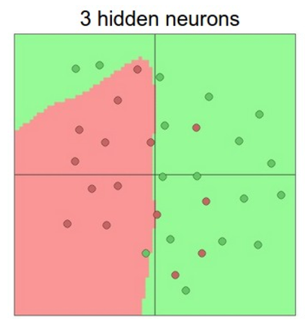
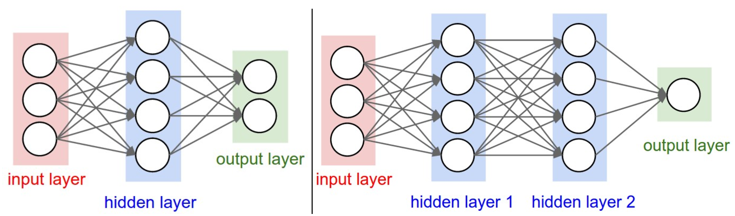
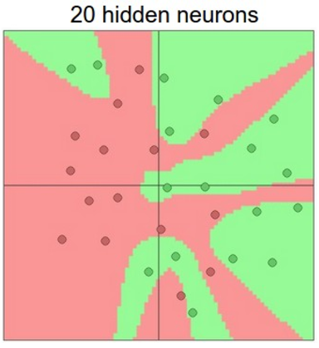
Feed-Forward Neural Networks
Feed-Forward Neural Networks (FNN)
Fully Connected Neural Networks (FCN)
Multilayer Perceptron (MLP)
The simplest neural network
Fully-connected between layers
For data that has NO temporal or spatial order
http://cs231n.stanford.edu/

Slide 7
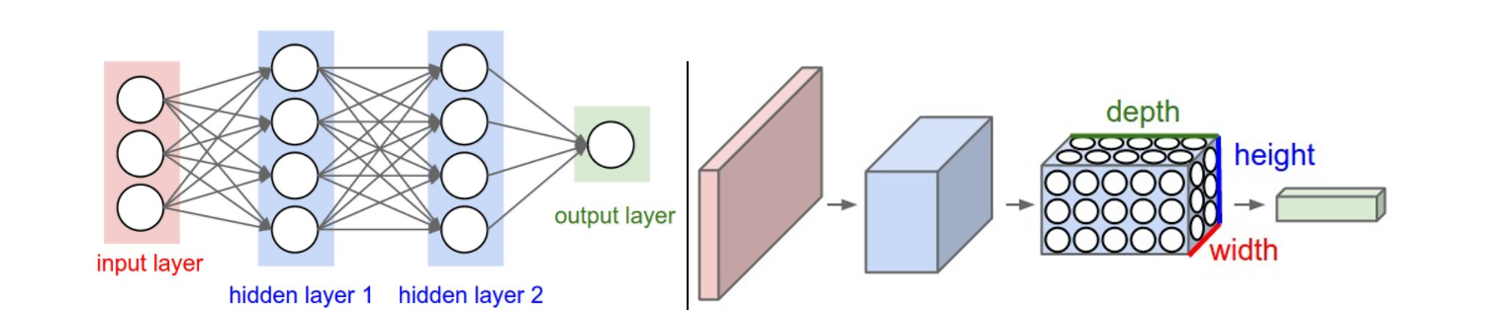
Convolutional Neural Networks
Neurons in one flat layer
Neurons in 3 dimensions
For images or data with spatial order
Can stack up to >100 layers
http://cs231n.stanford.edu/

Slide 8
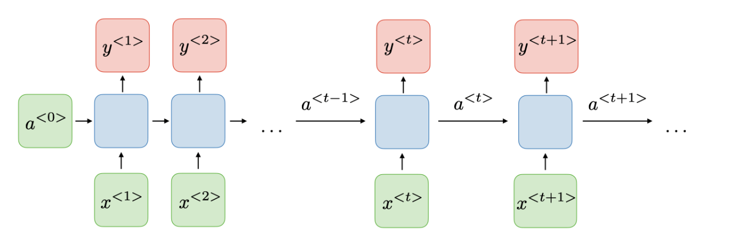
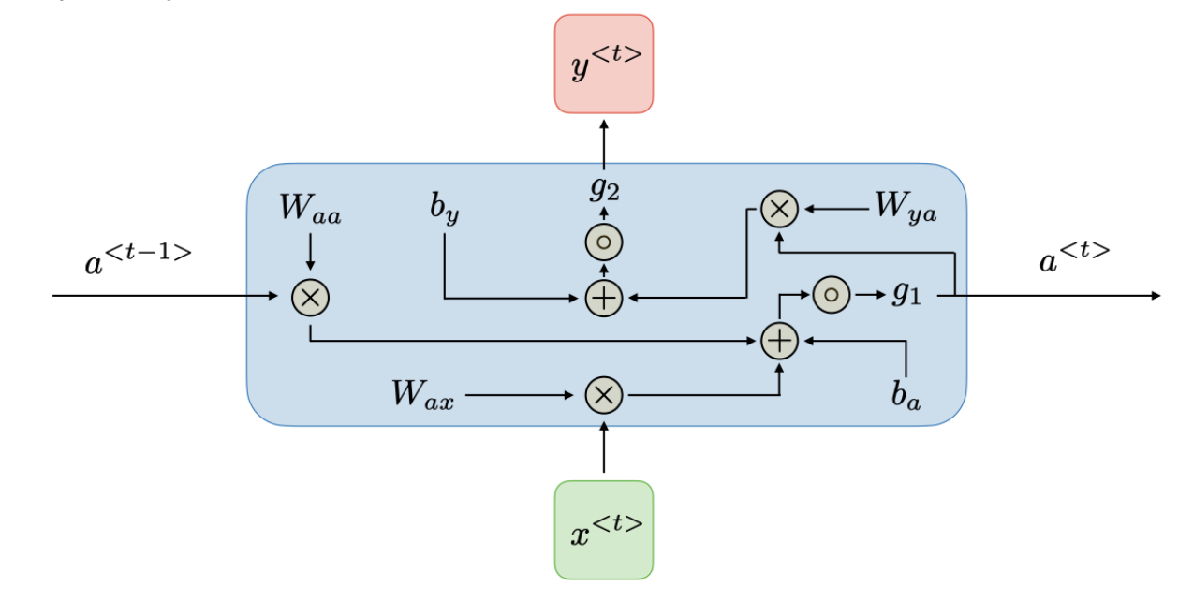
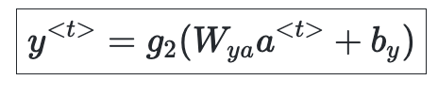
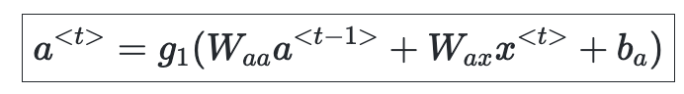
Recurrent Neural Networks
Traditional RNN
https://stanford.edu/~shervine/teaching/cs-230/cheatsheet-recurrent-neural-networks

Slide 9
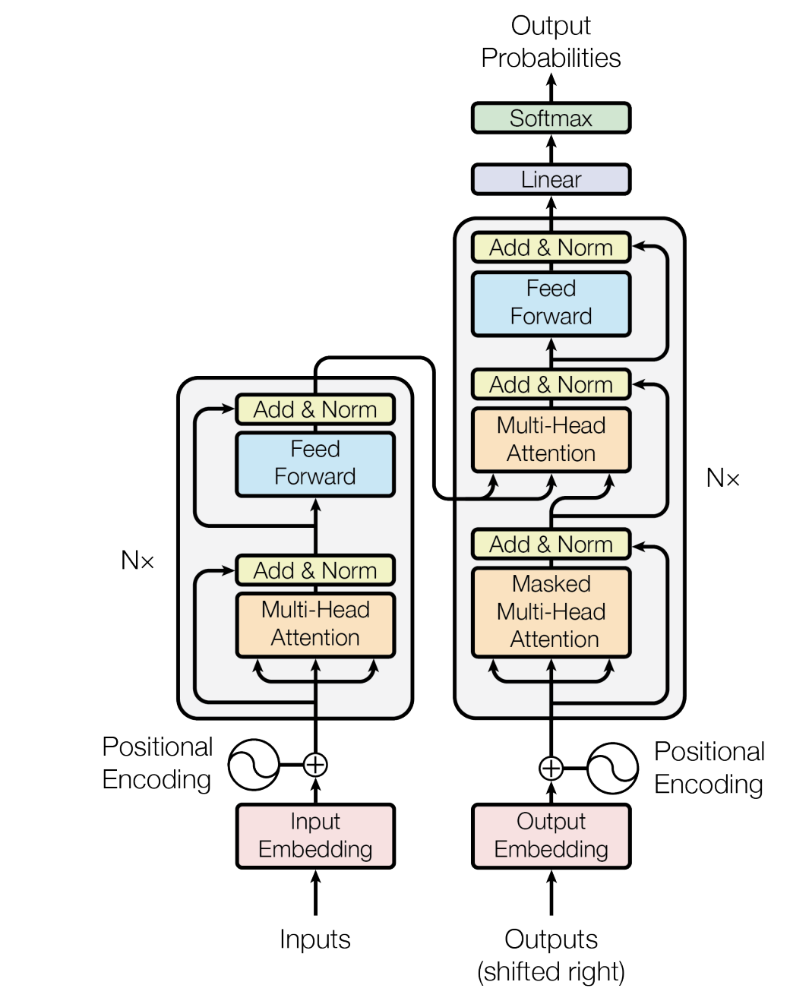
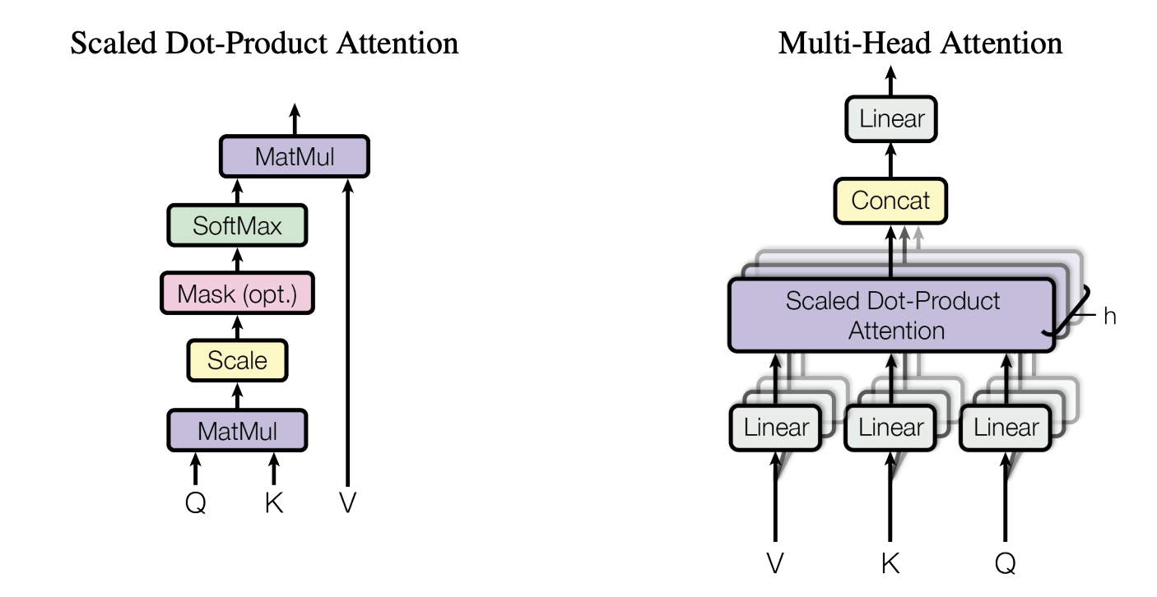
Transformers
Transformer: a new type of DNNs based on attention
Encoder
Decoder
Vaswani, Ashish, et al. "Attention is all you need." Advances in neural information processing systems 30 (2017)

Slide 10
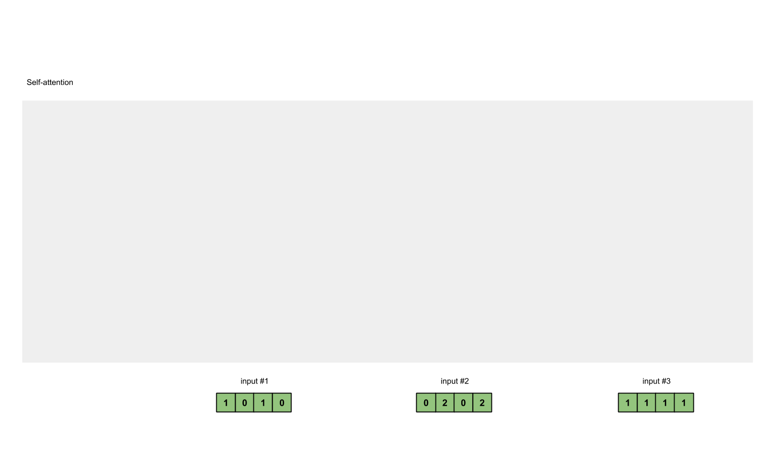
Self-Attention Explained
https://towardsdatascience.com/illustrated-self-attention-2d627e33b20a

Slide 11
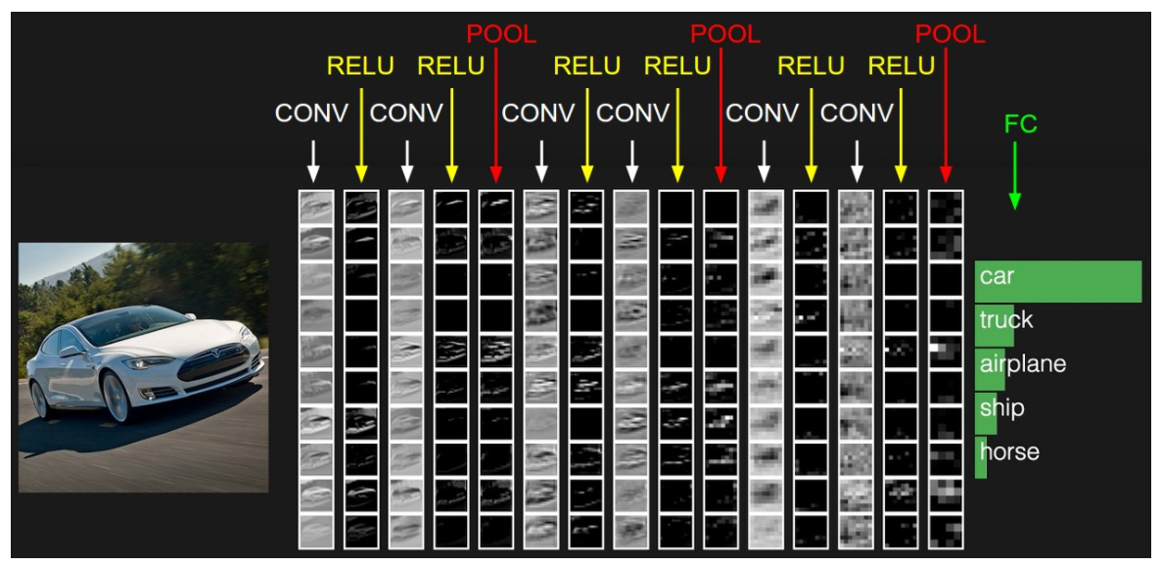
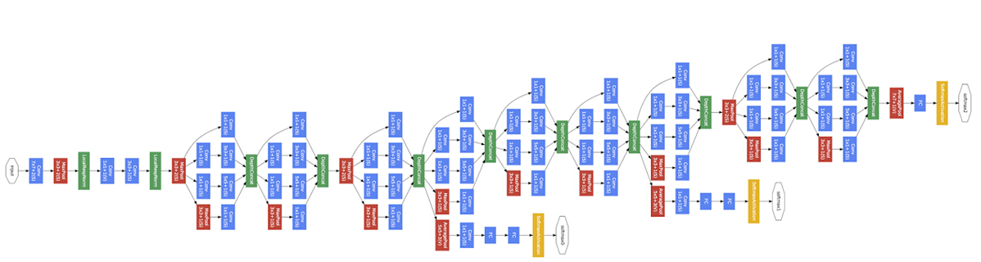
CNN Explained
A brief history of CNNs:
LeNet, 1990s
AlexNet, 2012
ZF Net, 2013
GoogLeNet, 2014
VGGNet, 2014
ResNet, 2015
Inception V4, 2016
ResNeXt, 2017
ViT, 2021
Learns different levels of representations
An Image is Worth 16x16 Words: Transformers for Image Recognition at Scale, ICLR 2021
http://cs231n.stanford.edu/

Slide 12
Explainable AI
深度学习可解释性
学习机理
推理机理
泛化机理
认知机理
鲁棒性
学习过程
学习结果
决策依据
推理机制
泛化原因
泛化条件
认知科学
认知启发的智能
普通鲁棒性
对抗鲁棒性
我们想要弄清楚下列问题：
DNN是怎么学习的、学到了什么、靠什么泛化、在什么情况下行又在什么情况下不行？
深度学习是否是真正的智能，与人类智能比谁更高级，它的未来是什么？
是否存在大一统的理论，不但能解释而且能提高？

Slide 13
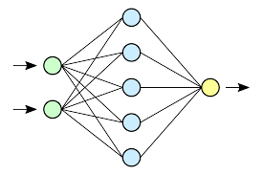
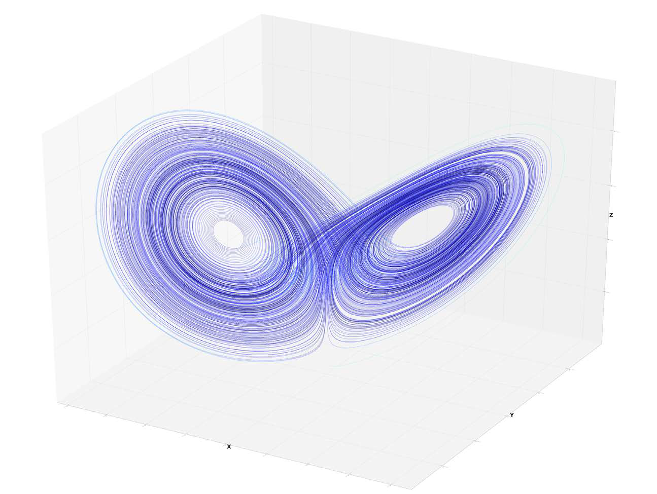


Methodological Principles
Visualization
Model
Component
Layer
Operation
Neuron
Superclass
Class
Training/Test set
Subset
Sample
Training
Inference
Transfer
Ablation
Contrast
Reverse

Slide 14
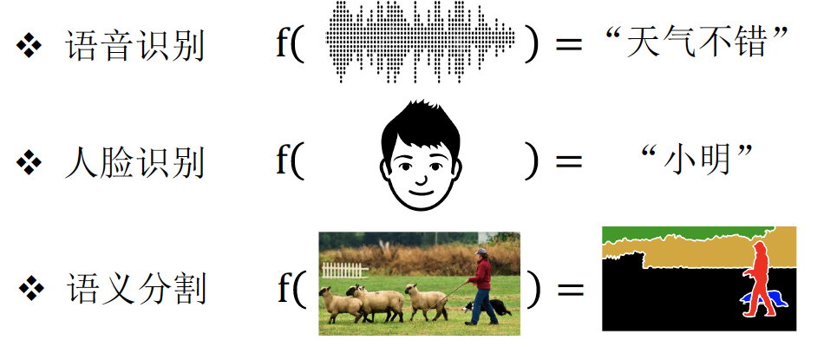
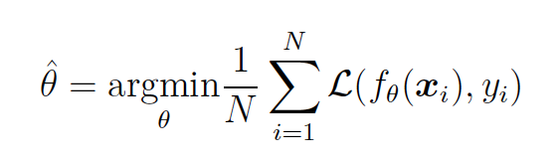
How to Understand Machine Learning
Learning is the process of empirical risk minimization (ERM)

Slide 15
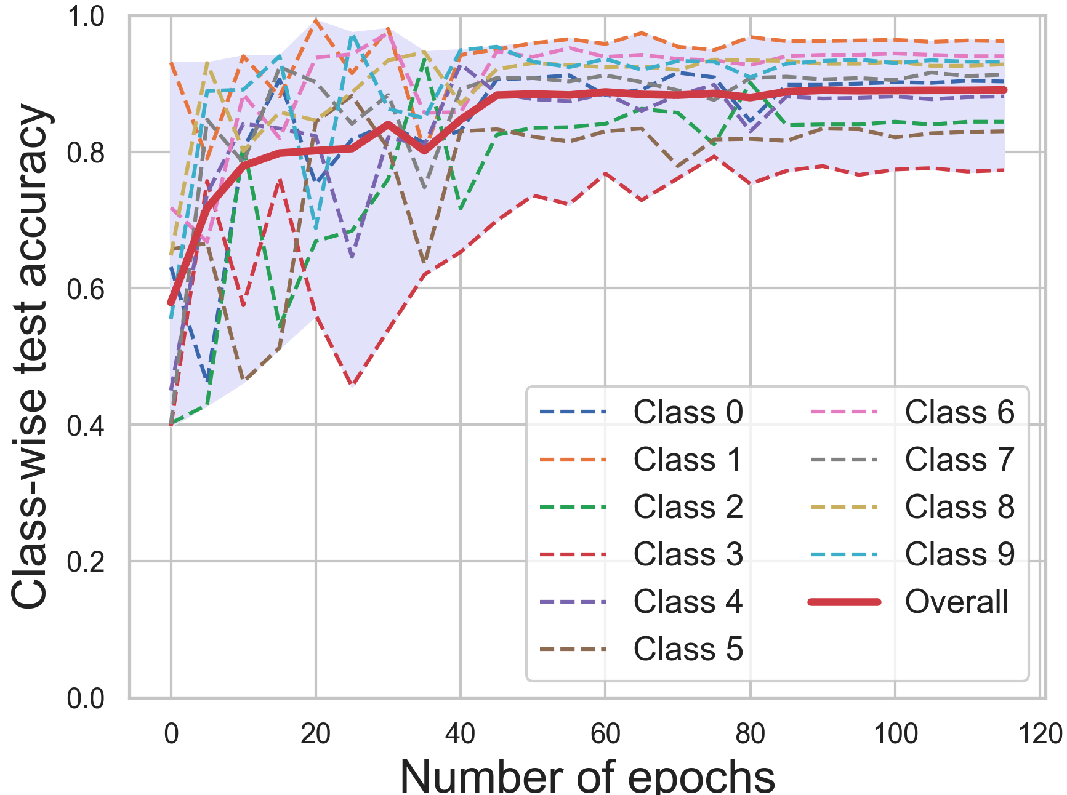
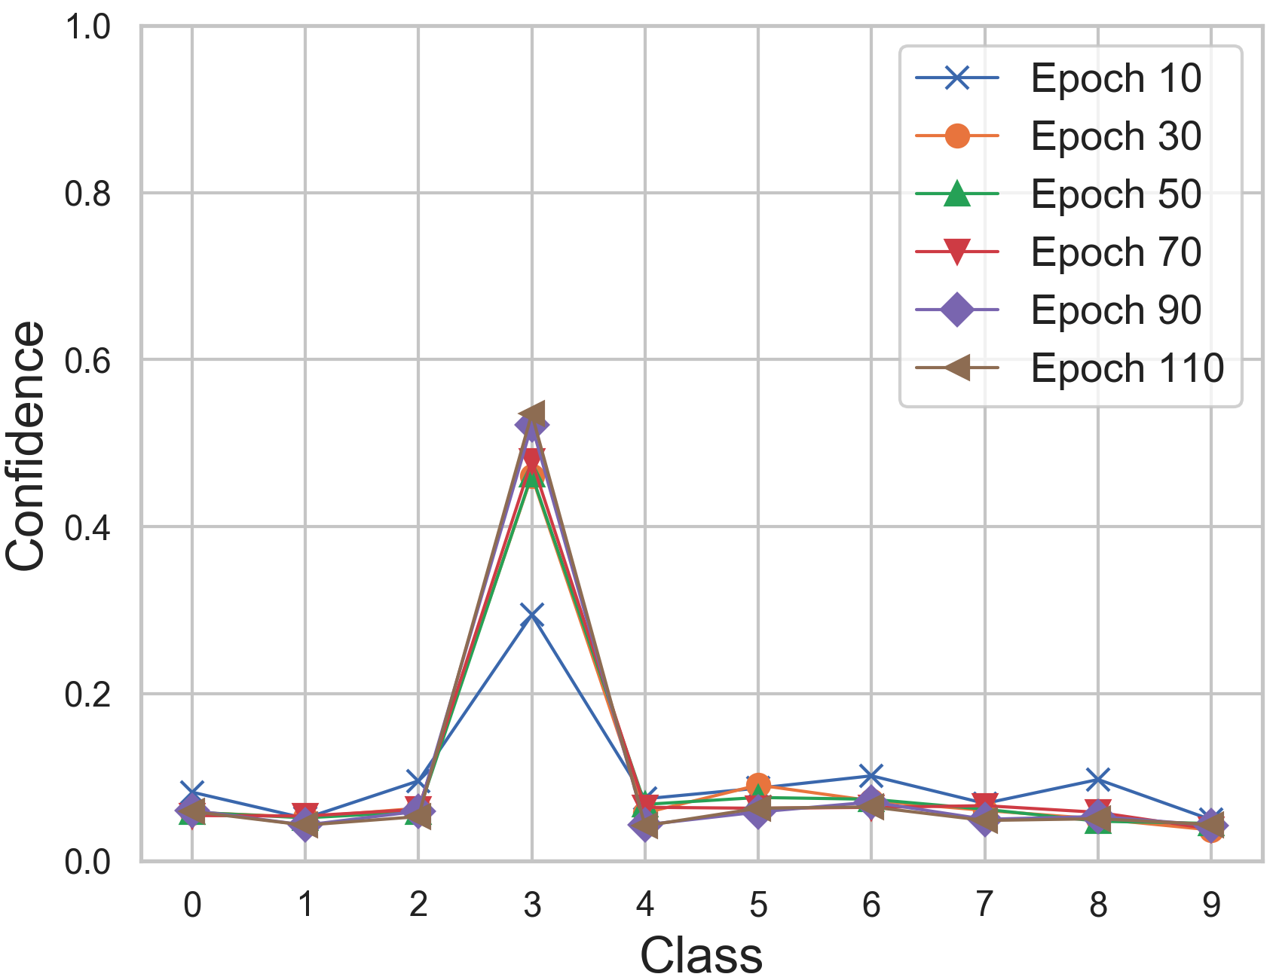
Learning Mechanism
Training/Test Error/Accuracy
Prediction Confidence
Explanation via observation: just plot!
Wang et al. Symmetric Cross Entropy for Robust Learning with Noisy Labels, ICCV 2019.

Slide 16
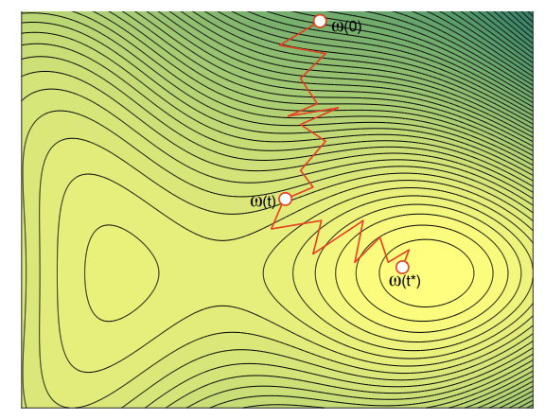
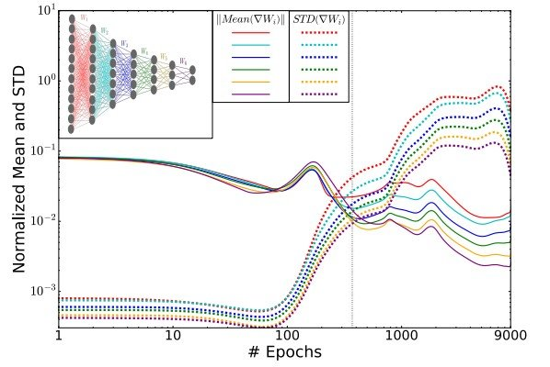
Learning Mechanism
Parameter dynamics
Gradient dynamics
Explanation via dynamics and information
TRADI: Tracking deep neural network weight distributions, ECCV 2020; Shwartz-Ziv R, Tishby N. Opening the black box of deep neural networks via information[J]. arXiv:1703.00810, 2017.

Slide 17
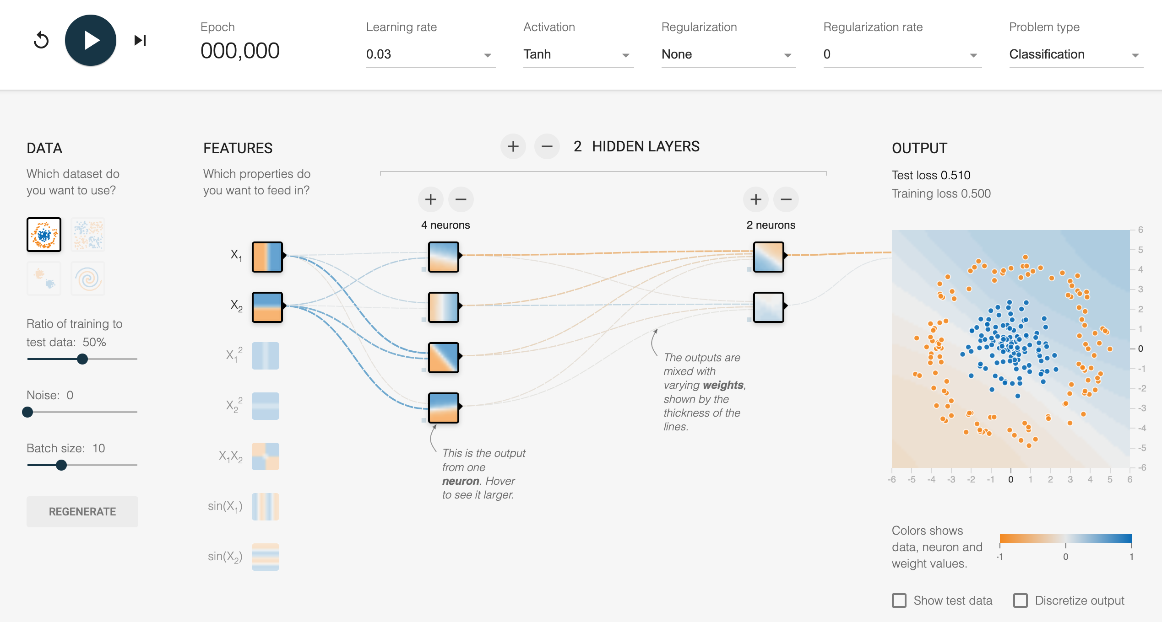
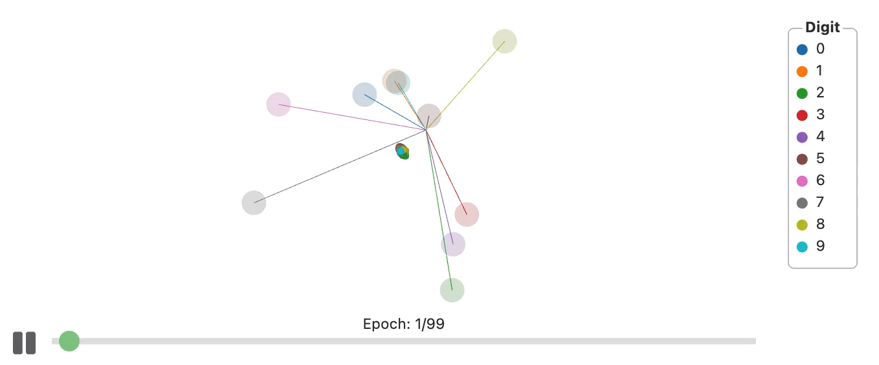
Learning Mechanism
Decision boundary, learning process visualization
Explanation via dynamics and information
https://distill.pub/2020/grand-tour/ （March 16, 2020）; https://playground.tensorflow.org/

Slide 18
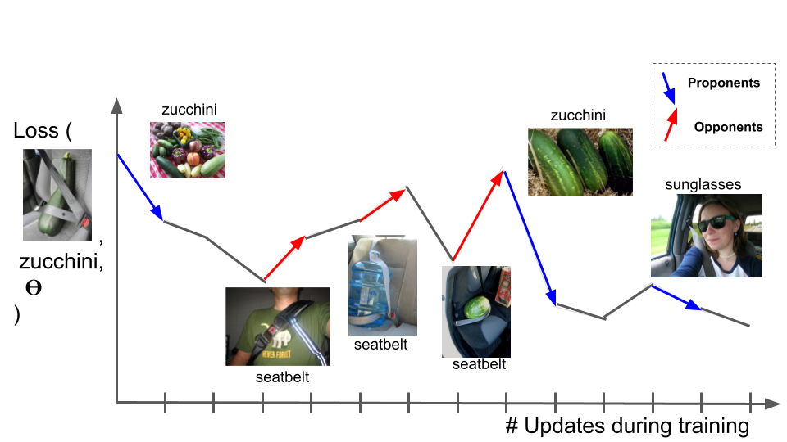
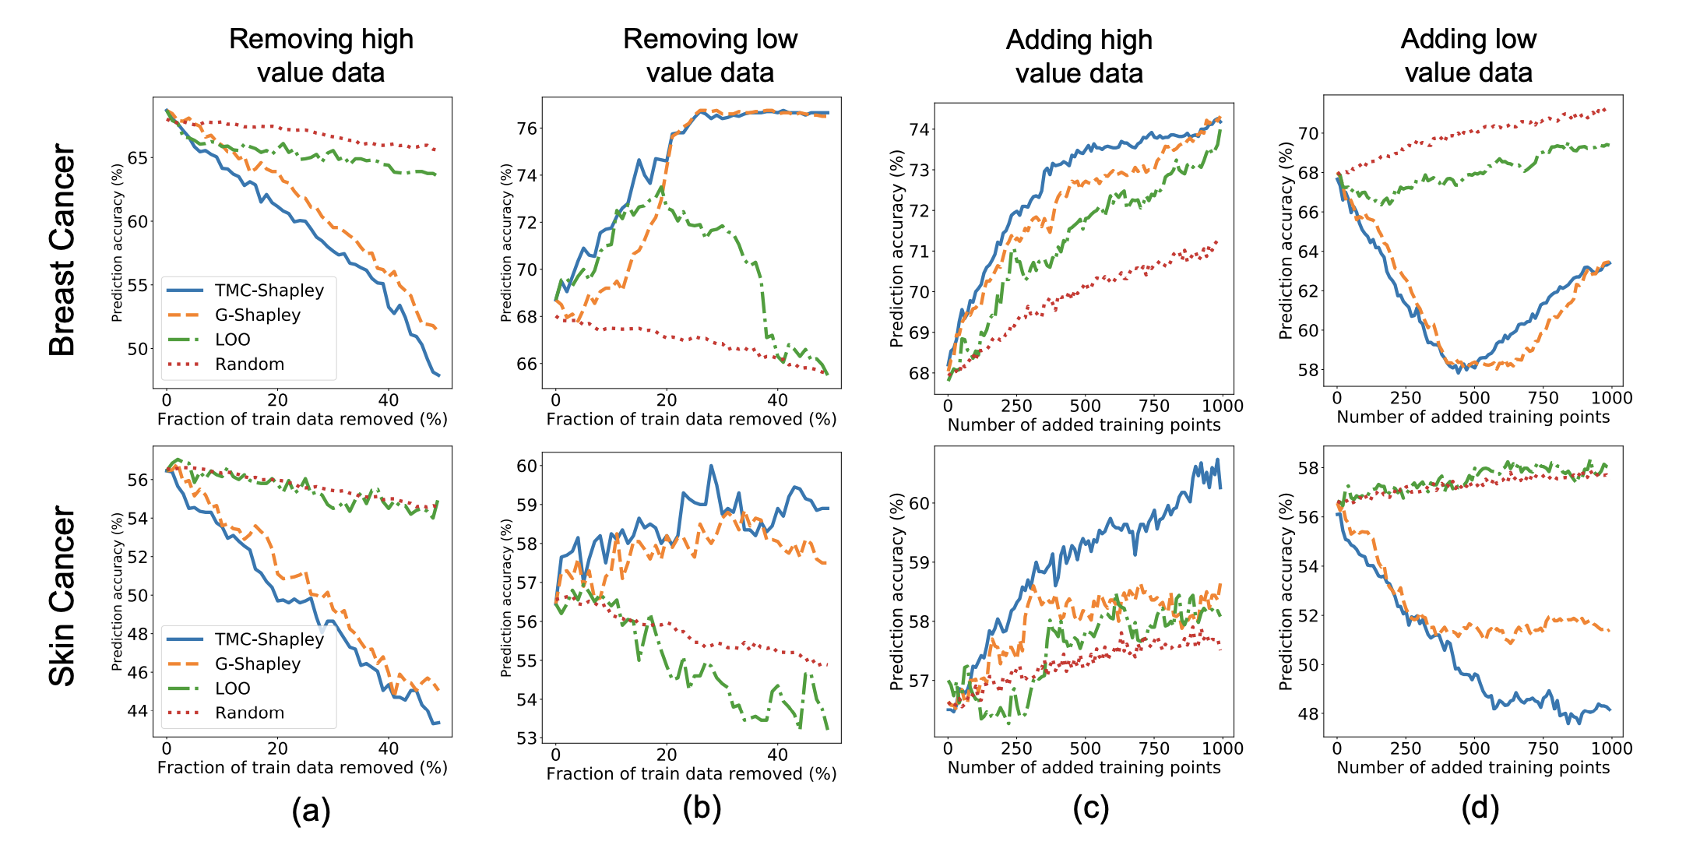
Learning Mechanism
Data influence/valuation: how a training sample impacts the learning outcome?
Influence Function
Data Shapley
Understanding Black-box Predictions via Influence Functions, ICML, 2018;
Pruthi G, Liu F, Kale S, et al. Estimating training data influence by tracing gradient descent. NeurIPS, 2020.
Data shapley: Equitable valuation of data for machine learning, ICML, 2019.

Slide 19
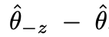
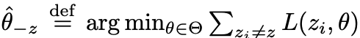
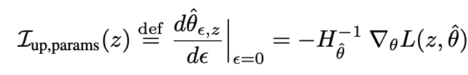
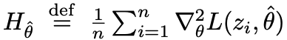
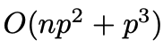
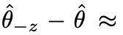
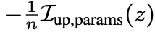
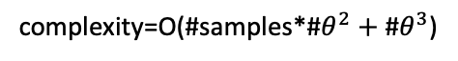
Influence Function
How model parameter would change if a sample z is removed from the training set?
目标：
How model parameter would change if z is upweighted by a small constant $ε$?
Cook, R. D. and Weisberg, S. Residuals and influence in regression. New York: Chapman and Hall, 1982
Removing sample z is equivalent to upweighting it by $ε=−\frac{1}{n}$
所以：
complexity=O(#samples*#$θ^{2}+$ #$θ^{3}$)
Understanding Black-box Predictions via Influence Functions, ICML, 2018;

Slide 20
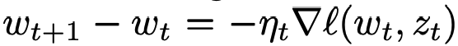
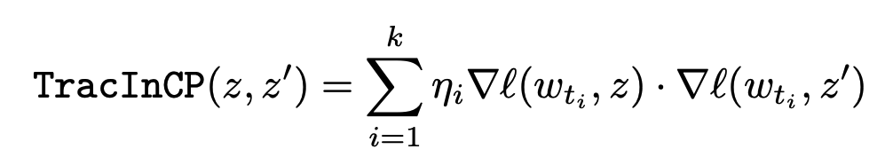
Training Data Influence
How model loss on z’ would change if update on a sample z?
First-order approximation of the above (assuming one step update is small)?
Checkpoints store the interim updates
所以：
Pruthi G, Liu F, Kale S, et al. Estimating training data influence by tracing gradient descent. NeurIPS, 2020

Slide 21
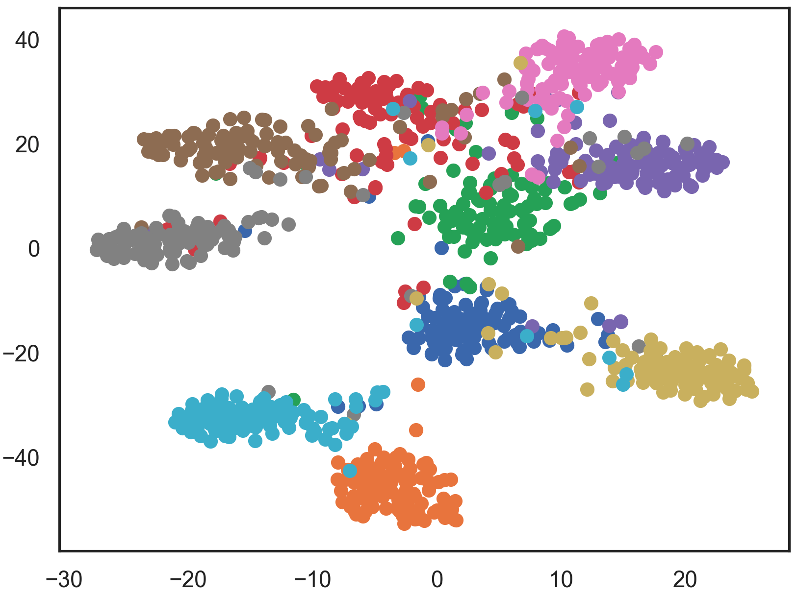
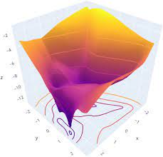
Understanding the Learned Model
Deep features
Loss Landscape
t-SNE plot
Maaten et al. Visualizing data using t-SNE. JMLR, 2008.
https://distill.pub/2016/misread-tsne/?_ga=2.135835192.888864733.1531353600-1779571267.1531353600

Slide 22
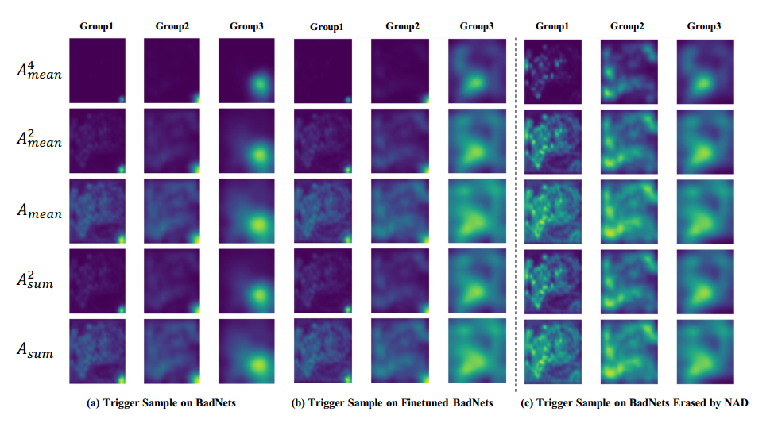
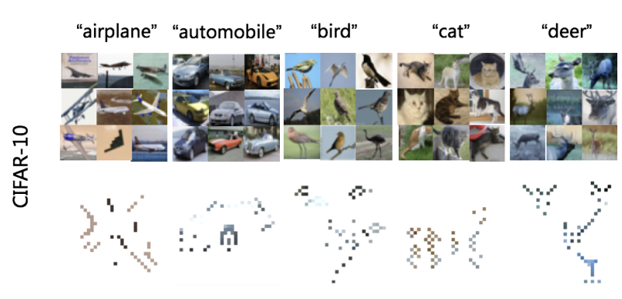
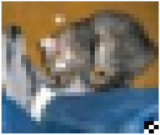
Understanding the Learned Model
Intermediate Layer Activation Map
Class-wise Patterns
Activation/Attention Map
One predictive pattern for each class
Li et al. Neural Attention Distillation: Erasing Backdoor Triggers from Deep Neural Network, ICLR 2021; Zhao et al. What do deep nets learn? class-wise patterns revealed in the input space. arXiv:2101.06898 (2021).

Slide 23

What do deep nets learn?
Goal: understanding knowledge learned by a model of a particular class.
Method: Extract one single pattern for one class, then what this pattern would be?
Other considerations: we need to do this in pixel space, as they are more interpretable
Zhao, Shihao, et al. "What do deep nets learn? class-wise patterns revealed in the input space." arXiv:2101.06898 (2021).

Slide 24






How to Find the Class-wise Pattern
: a canvas image
Patterns extracted on different canvases (red rectangles)

Slide 25


Class-wise Patterns Revealed
Patterns extracted on original, non-robust, robust CIFAR-10and patterns of adversarially trained models
Predictive power of different sizes of patterns

Slide 26



Inference Mechanism
Guided Backpropagation
Class Activation Map (Grad-CAM)
Selvaraju et al. Grad-cam: Visual explanations from deep networks via gradient-based localization. ICCV 2017.
Springenberg et al. Striving for Simplicity: The All Convolutional Net, ICLR 2015.

Slide 27




Guided Backpropagation
ReLU forward pass
ReLU backward pass
Deconvolution for ReLU
Guided Backpropagation
Springenberg et al. Striving for Simplicity: The All Convolutional Net, ICLR 2015. https://medium.com/@chinesh4/generalized-way-of-interpreting-cnns-a7d1b0178709

Slide 28

Class Activation Mapping (CAM)
GAP: Global Average Pooling
Zhou et al. Learning Deep Features for Discriminative Localization. CVPR, 2016. https://medium.com/@chinesh4/generalized-way-of-interpreting-cnns-a7d1b0178709

Slide 29



Grad-CAM
Grad-CAM is a generalization of CAM
$y^{c}$：logits of class c (before softmax)
$A^{k}$：k-th channel activation map
Compute neuron importance:
Weighted combination of activation map, then interpolation:
B. Zhou, A. Khosla, L. A., A. Oliva, and A. Torralba. Learning Deep Features for Discriminative Localization. In CVPR, 2016; https://medium.com/@chinesh4/generalized-way-of-interpreting-cnns-a7d1b0178709

Slide 30





LIME
Local Interpretable Model-agnostic Explanations (LIME)
$π_{x}$：local neighborhood of $x$
$z$：sampled neighbor points
$g$：explainer e.g a linear model
$z′$：a binary vector for interpretable representation(e.g. patch)
Ribeiro et al. “Why should i trust you?” Explaining the predictions of any classifier.“ SIGKDD, 2016.
https://github.com/marcotcr/lime

Slide 31




Integrated Gradients
There is a path: $x_{i} →x_{i}^{′}$
Traverse the path using $α$
Integrate the gradients along the way
Sundararajan M, Taly A, Yan Q. Axiomatic attribution for deep networks, ICML, 2017.
https://github.com/TianhongDai/integrated-gradient-pytorch

Slide 32

Cognitive Distillation
Mask extract by cognitive distillation
Huang et al. Distilling Cognitive Backdoor Patterns within an Image, ICLR 2023

Slide 33
Useful and non-useful features
Useful features:
highly correlated with the true label in expectation, so
If removed, prediction change
Backdoor trigger is a useful feature
Non-useful features:
not correlated with prediction
If removed, prediction does not change
Ilyas, Andrew, et al. "Adversarial examples are not bugs, they are features.” NeurIPS 2019
Notes:
Our work is inspired by the existing useful feature.
These features are highly corelated with the label
Backdoor trigger is a form of powerful useful feature since it can controls model’s prediction whenever it appears.
There are also non-useful feature, which are not correlated with the label.
If we can remove the non-useful feature from the image through some optimization, the remaining should be useful feature

Slide 34

Cognitive Distillation
Objective: distill the minimal essence of useful features
Notes:
We propose a method to extract he minimal essence of the useful features through the following optimization method.

Slide 35

Cognitive Distillation
Total Variation Loss
Model
Cognitive
Pattern
Original image
Mask
Random noise vector

Slide 36

Distilled patterns on backdoored samples
_{x}
_{m}
x_{cp}
Notes:
Here are some visualization. The first row are original inputs, the second row are the mask, third row are the cognitive pattern. Each column represents different model trained with different attacks.
The first column are the clean input extracted on the BadNets.
From the visualization, we can observes that for a clean input image, the model focus on the main object. For the backdoored image, the model focus on the suspiciously small, sparse, and semantically meaningless features.
We can also observes that even the backdoor trigger span over the entire image, for example DFST, the model only rely on some small amount of pixels.

Slide 37

How to Verify Cognitive Patterns are Essential
Construct simplified backdoor patterns:
Backdoored image
Binarized mask {0,1}
Original image
Notes:
Now let’s verify the pattern we extracted are still useful as a backdoor trigger.
Here, for each attack, and each training instance, we generate a backdoor sample x_bd’ with simplified trigger using this equation.
M is the binarized mask
X_bd is the original backdoored image
X is the original clean image
Put simply, here we replace non-useful features with original image and useful features are the original backdoor trigger.

Slide 38
Backdoor Patterns Can Be Made Simpler
_{x}
_{m}
x_{cp}
x_{bd’}
Notes:
The last row in the visualization are the simplified version of the backdoor image.
For attacks with trigger span over entire image, the simplified trigger can reduce to 40% of the original size.

Slide 39

Backdoor Patterns Can Be Made Simpler
Simplified backdoor patterns also work!
Notes:
Next we train a model on poisoned dataset with simplified trigger, and we use original trigger to evaluate these model. In other word, only the training set is simplified but not the test set.
This figure here shows the attack success rate.
Data poisoned with original trigger is red one, and blue is the simplified version.
We can observes that for most of the attacks, the simplified trigger are equally effective.
This means the cognitive pattern we extracted are truly useful and are the key for the backdoor attacks.

Slide 40

L1 Norm Distribution of the Distilled Mask
Notes:
We use the L1 norm of the extracted mask to detect backdoor samples
Here are the distributions of the L1 norm of the mask on the training set.
Red for the backdoor samples and blue clean samples, clearly the L1 norm for backdoor samples are much lower.

Slide 41
Detect Backdoor Samples
Attacks: 12 backdoor attacks
Models : ResNet-18, Pre-Activation ResNet-101, MobileNet v2, VGG-16, Inception, EfficientNet-b0
Datasets: CIFAR-10 / GTSRB / ImageNet subset
Evaluation metric: area under the ROC curve (AUROC)
Detection baselines:
Anti-Backdoor Learning (ABL) [2]
Activation Clustering (AC) [3]
Frequency [4]
STRIP [5]
Spectral Signatures [6]
CD-L (logits layer) and CD-F (last activation layer)

Slide 42

Superb Detection Performance

Slide 43

Discover Biases in Facial Recognition Models
CelebA dataset:
40 binary facial attributes (gender, bald, and hair color)
Known bias between gender and blond hair
Apply CD in the same way as backdoor detection
Select subset of samples with low L1 norm
Examine attributes of the subset
Calculate distribution shift between subset and the full dataset

Slide 44

Discover Biases in Facial Recognition Models
Masks distilled for predicting each attribute

Slide 45

Discover Biases in Facial Recognition Models

Slide 46






Generalization Mechanism
Deep Learning Theory
Convergence
Convergence
Generalization
Convex (Linear model)
Nonconvex (DNN)
Saddle point
Generalization
‘Cat’
‘Cat’?
Training time
Test time
Traditional theory: simpler model is better, more data is better

Slide 47


Generalization Theory
Components of Generalization Error Bounds
generalization
error
empirical
error
hypothesis
class
complexity
confidence
sample size
RHS: for all terms, the lower the better:
small training error
simpler model class
more samples
less confidence
https://www.cs.cmu.edu/~ninamf/ML11/lect1117.pdf; https://www.youtube.com/watch?v=zlqQ7VRba2Y

Slide 48

Generalization Theory
Small training error ≠ low generalization error
Zero training error was achieved on purely random labels (meaningless learning)
0 training error vs. 0.9 test error
Zhang et al. Understanding deep learning requires rethinking generalization. ICLR 2017.

Slide 49
List of Existing Theories
Rademacher Complexity bounds (Bartlett et al. 2017)
PAC-Bayes bounds (Dziugaite and Roy 2017)
Information bottleneck (Tishby and Zaslavsky 2015)
Neural tangent kernel/Lazy training (Jacot et al. 2018)
Mean-field analysis (Chizat and Bach 2018)
Doule Descent (Belkin et al. 2019)
Entropy SGD (Chaudhari et al. 2019)
A few interesting questions:
Should we consider the role of data in generalization analysis?
Should representation quality appear in the generalization bound?
Generalization is about math (the function of the model) or knowledge?
https://www.youtube.com/watch?v=zlqQ7VRba2Y

Slide 50
How to visualize generalization?
Existing approaches
test error
Visualization: loss landscape, prediction attribution, etc.
Training -> test: distribution shift, out-of-distribution analysis
Noisy labels in test data – questioning data quality and reliable evaluation
The remaining questions:
how generalization happens?
Math ≠ Knowledge
Computation = finding patterns or understanding the underlying knowledge
What is the relation of computational generalization to human behavior?

Slide 51



Cognitive Mechanism
OpenAI reveals the multimodal neurons in CLIP
https://openai.com/blog/multimodal-neurons/; https://openai.com/blog/clip/

Slide 52

Cognitive Mechanism
shape match = prob means shape bias
cognitive psychology inspired evaluation of DNNs
Ritter et al. Cognitive Psychology for Deep Neural Networks: A Shape Bias Case Study, ICML, 2017

Slide 53

Cognitive Mechanism
Deep neural networks solve problems by taking shortcuts
Geirhos, Robert, et al. "Shortcut learning in deep neural networks." Nature Machine Intelligence 2.11 (2020): 665-673.

Slide 54

Cognitive Mechanism
Behavioral Prediction Task: Human vs. Monkey vs. Deep Nets
Rajalingham, Rishi, et al. “Large-scale, high-resolution comparison of the core visual object recognition behavior of humans, monkeys, and state-of-the-art deep artificial neural networks.” Journal of Neuroscience 38.33 (2018): 7255-7269. Rajalingham, Rishi, Kailyn Schmidt, and James J. DiCarlo. "Comparison of object recognition behavior in human and monkey." Journal of Neuroscience 35.35 (2015): 12127-12136.

Slide 55


NLP Knowledge Neurons
Knowledge extraction/distillation
Knowledge understanding
Knowledge update
Knowledge erasing
Common belief:
The FFN of a Transformer stores knowledge
Dai, Damai, et al. "Knowledge neurons in pretrained transformers." arXiv:2104.08696 (2021).

Slide 56

FudanNLP TextFlint
https://distill.pub/2018/building-blocks/

Slide 57


FudanNLP TextFlint
https://textflint.github.io/; https://github.com/textflint/textflint

Slide 58

What is Missing
Many theoretical work or interpretation tools have been proposed
Yet, we don’t have an all-in-one system to explain everything.

Slide 59
A little bit more on: Common Robustness
Texture bias
Robustness to common corruptions

Slide 60






Texture bias
Human
DNNs
Temporary solution: Data Augmentation (Style Transfer)
ImageNet -> Stylized-ImageNet
Geirhos, Robert, et al. "ImageNet-trained CNNs are biased towards texture; increasing shape bias improves accuracy and robustness." ICLR, 2019.

Slide 61


Common Corruptions
ImageNet-C:
15 types of noise
5 severity levels
ImageNet-P:
10 types of perturbation
Current solution: Data augmentation vs. Adversarial Training
Hendrycks&Dietterich. “Benchmarking Neural Network Robustness to Common Corruptions and Perturbations.” ICLR, 2019.

Slide 62
谢谢！

